Slide 1

Advanced x86: BIOS and System Management Mode Internals Unified Extensible Firmware Interface (UEFI)
Xeno Kovah && Corey Kallenberg
LegbaCore, LLC

Slide 2
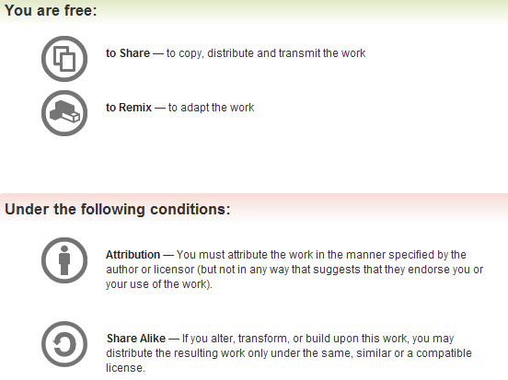
All materials are licensed under a Creative Commons “Share Alike” license.
http://creativecommons.org/licenses/by-sa/3.0/
Attribution condition: You must indicate that derivative work
"Is derived from John Butterworth & Xeno Kovah’s ’Advanced Intel x86: BIOS and SMM’ class posted at http://opensecuritytraining.info/IntroBIOS.html”
Notes:
Attribution condition: You must indicate that derivative work
"Is derived from John Butterworth & Xeno Kovah’s ’Advanced Intel x86: BIOS and SMM’ class posted at http://opensecuritytraining.info/IntroBIOS.html”

Slide 3

Introduction
In the talks we've been giving for the last year, we've repeatedly referred to the new UEFI (Unified Extensible Firmware Interface) as a double-edged sword.
there are things about it that help attackers, and things that help defenders.
This is a more thorough examination of that assertion

Slide 4

BIOS is dead, long live UEFI!
Not quite
We'll never be rid of certain elements of legacy BIOS on x86
The initial code will always be hand-coded assembly (or at least C with lots of inline asm), because C doesn't have semantics for setting architecture-dependent registers.
On all modern systems Intel makes extensive use of PCI internal to their own CPUs, therefore early in system configuration there will always be plenty of port IO access to PCI configuration space, where you're going to be at a loss for what is happening to what, until you do extensive looking up of things in manuals
Add to that plenty of port IO to devices where you have no idea what's being talked to, since there's no documentation
The bad old days live on, and you still have to learn them…
But there's a whole lot more new interesting and juicy bits added in to the system to be explored
Notes:
https://www.flickr.com/photos/zeusandhera/2786778672/?rb=1

Slide 5
BIOS/UEFI Commonalities
BIOS and UEFI share 2 common traits:
CPU entry vector on the SPI flash chip is the same
They sufficiently configure the system so that it can support the loading & execution of an Operating System
They go about it in different ways
call it different names: POST/BIOS vs. Platform Initialization
This should include properly locking down the platform for security
Where software meets bare metal the machine instructions are the same (i.e.: PCI configuration, MTRRs, etc…)
UEFI, however, is a publically documented, massive framework
Has an open-source reference implementation called the EDK2
The UDK (UEFI Development Kit) is analogous to a “release tag” of the “cutting edge” EDK2 (EFI Development Kit)

Slide 6

About UEFI
UEFI = Unified Extensible Firmware Interface
As the name implies, it provides a software interface between an Operating System and the platform firmware
The “U” in UEFI is when many other industry representatives became involved to extend the original EFI
Companies like AMD, American Megatrends, Apple, Dell, HP, IBM, Insyde, Intel, Lenovo, Microsoft, and Phoenix Technologies
Originally based on Intel’s EFI Specification (1.10)
Does provide support for some legacy components via the Compatibility Support Module (CSM)
Helps vendors bridge the transition from legacy BIOS to UEFI
It’s much larger than a legacy BIOS
(And the attackers rejoiced!)
Notes:
http://commons.wikimedia.org/wiki/File:Devil_cartoon_charactor.gif

Slide 7
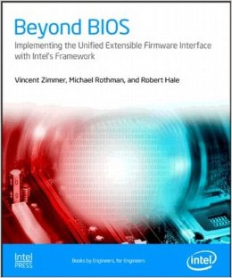
Something you may want to read
If you don't want to just dive into the thousands of pages of UEFI specifications, a good overview is also given in Beyond BIOS: Developing with the Unified Extensible Firmware Interface 2nd Edition by Zimmer et al.
Otherwise go enjoy the specs here: http://www.uefi.org/specifications

Slide 8
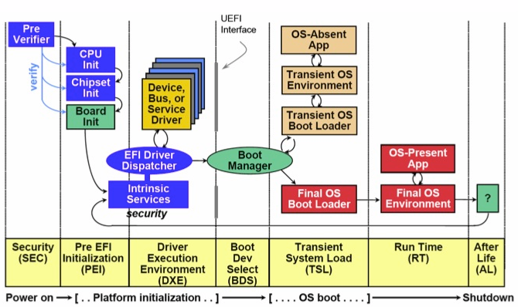
UEFI Differences: Boot Phases
7 Phases total
Each phase is defined via specification
We’ll briefly talk about the first 2 phases and then talk about Secure Boot and UEFI debugging

Slide 9
Legacy BIOS Equivalent
However, everything we have covered up to this point is mostly performed within these first 2 phases
Chipset configuration, etc.
Some SMM stuff happens in the 2nd phase (PEI), some in the 3rd (DXE)
For this reason, we’ll only briefly cover these first 2 phases
Platform Initialization Spec Vol. 1, Version 1.3

Slide 10
SEC (Security) Phase
The SEC phase is the first phase in the PI architecture
Contains the first code that is executed by the CPU
Environment is basically that of legacy:
Small/minimal code typically hand-coded assembly so architecturally dependent and not portable
Executes directly from flash
Will be uncompressed code
Platform Initialization Spec Vol. 1, Version 1.3, Sec. 13
Notes:
So very similar to legacy BIOS at this point

Slide 11
SEC (Security) Phase: Architecture vs. Implementation
This picture is architecturally correct. The SEC phase should involve some amount of measurement and verification of the first code to run
Realistically if you look at the SEC core module, you will find that it actually is almost entirely CPU/Chipset/Board initialization handcoded asm
“In theory, theory and practice are the same. In practice, they are not.”
Platform Initialization Spec Vol. 1, Version 1.3, Sec. 13
Notes:
So very similar to legacy BIOS at this point

Slide 12
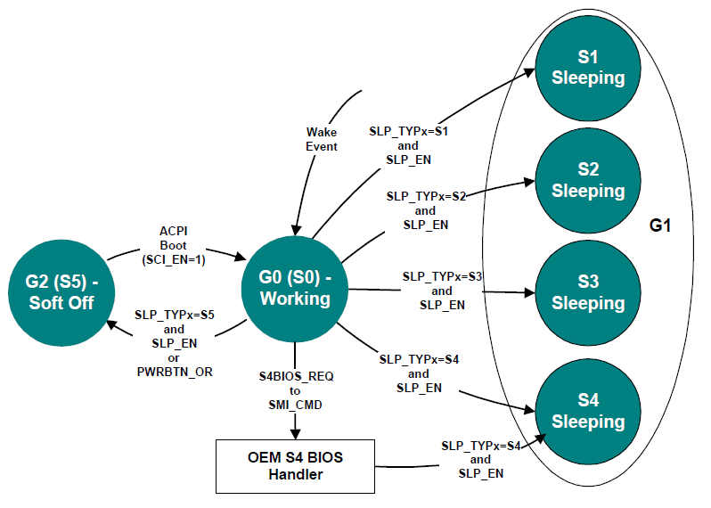
SEC Responsibilities 1 of 2
The SEC phase handles all platform reset events
All system resets start here (power on, wakeup from sleep, etc)
ACPI Global Power States, ACPI 5.0 Spec
System boot will follow a different path based on what power state its in on startup!
This includes a wake-event from sleep mode, etc.
We’ll not be discussing ACPI at this time, but you can find more information in the ACPI spec:
http://www.acpi.info/DOWNLOADS/ACPIspec50.pdf
Platform Initialization Spec Vol. 1, Version 1.3, Sec. 13

Slide 13
SEC Responsibilities 2 of 2
Implements a temporary memory store by configuring the CPU Cache as RAM (CAR)
Also called “no evictions mode”
Memory has not yet been configured, so all read/writes must be confined to CPU cache
A stack is implemented in CAR to pave the way for a C execution environment (as in ANSI C)
The processor active at boot time (Boot Strap Processor) is the one whose cache is used
If you are interested in CAR, more info can be found here:
http://www.coreboot.org/images/6/6c/LBCar.pdf
Platform Initialization Spec Vol. 1, Version 1.3, Sec. 13
Notes:
Oddly enough I never observed the Dell legacy BIOS initialize CAR.

Slide 14
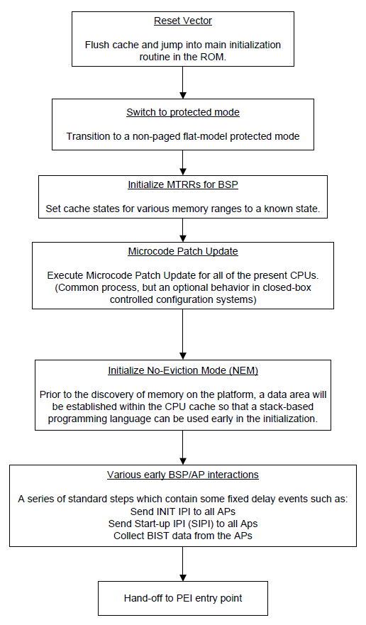
SEC Phase
Upon entry the environment is the same as on a legacy platform
Hardware settings, not BIOS settings
Processor is in Real Mode
Segment registers are the same
CS:IP = F000:FFF0
CS.BASE = FFFF_0000h
Entry vector is still a JMP
In the UDK2010 I have seen the WBINVD instruction performed prior to the initial JMP, but in later revisions of the UDK2012 it has been replaced with NOPs
Which made me wonder if it was possible to cache-poison the reset vector?
No, because caching is disabled automatically on reset!
Intel whitepaper: Reducing Platform Boot Times, Rothman, Figure 1
Notes:
BSP = Boot Strap Processor

Slide 15
SEC Phase
Immediate entry into protected mode after initial jump
UDK2012 vB12: Loads a GDT from FFFF_FF98h
UDK2012 vB12 does not load an IDT (not even a nominal one of all zeroes)
Just an observation, nothing wrong with this
Immediately following the entry into protected mode, the Boot Firmware Volume (BFV) is located
GUID: 8C8CE578-8A3D-4F1C-3599-35896185C32DD
Also locates the SecCore FFS
Intel whitepaper: Reducing Platform Boot Times, Rothman, Figure 1
Notes:
BSP = Boot Strap Processor

Slide 16
SEC Phase
In the UDK2012 vB12 MTRRs are initialized just before CAR is initialized
MTRR Default Memory Type is configured as Uncacheable
UDK2010 also write-protects the Boot Firmware Volume (BFV)
An MTRR PhysBase to FFF0_0005h
An MTRR PhysMask to FFF0_0800h
Intel whitepaper: Reducing Platform Boot Times, Rothman, Figure 1
Notes:
BSP = Boot Strap Processor

Slide 17
SEC Phase
At this point in the UDK2012/EDK2 we are in SecCoreEntry()
Cool paper on Microcode updates (by Ben Hawkes):
http://inertiawar.com/microcode/
Uses data and timing analysis to reveal some of the cryptographic design of the microcode update architecture
To an attacker, being able to modify the Microcode updates could mean they could “update” the CPU to an older revision which could contain exploitable traits/flaws, or simply insert changes to remove security checks and mechanisms
Note: CPU microcode updates are not permanently written to the CPU, microcode updates are (re)applied each time the system boots
Intel whitepaper: Reducing Platform Boot Times, Rothman, Figure 1
Notes:
BSP = Boot Strap Processor

Slide 18
SEC Phase
This is where Cache-As-RAM is initialized. No eviction mode means the CPU cache will not flush/sync to memory
IMO I think CAR is very interesting. CoreBoot source has some well-commented code that explains the procedure very well (also used in Chromium):
https://chromium.googlesource.com/chromiumos/third_party/coreboot/+/master/src/soc/intel/baytrail/romstage/cache_as_ram.inc
UDK2012 vB12 allocates 8000h bytes of CPU cache to be used as RAM
Stack region is placed in cache
MOV ESP, CAR_BASE_ADDR
Intel whitepaper: Reducing Platform Boot Times, Rothman, Figure 1
Notes:
BSP = Boot Strap Processor

Slide 19
SEC Phase
BIST here is Built-In Self Test that each processor performs before being “ready for duty”
I have not observed this but there is a good chunk of configuration code that I skimmed over.
I have not observed the other cores on the processor “wake-up” until the DXE phase
Intel whitepaper: Reducing Platform Boot Times, Rothman, Figure 1
Notes:
BSP = Boot Strap Processor

Slide 20
SEC Phase
Locates the PEI Core module
At this point it also configures some of the BARs (MCHBAR, PCIEXBAR, and some others)
But memory still has not yet been “discovered”
At handoff, BIOS_CNTL is set to 0x28 Prefetching and caching are initially allowed for SMM
BIOS Region SMM protection is enabled
SMM/SMRAM are not yet instantiated
Intel whitepaper: Reducing Platform Boot Times, Rothman, Figure 1
Notes:
BSP = Boot Strap Processor

Slide 21

SEC Hand-off to PEI Entry Point
Passing handoff information to the PEI phase (to PeiCore):
SEC Core Data
Points to a data structure containing information about the operating environment:
Location and size of the temporary RAM
Location of the stack (in temp RAM)
Location of the Boot Firmware Volume (BFV)
Located in flash file system by its GUID
GUID: 8C8CE578-8A3D-4F1C-3599-35896185C32DD3
If not found, system halts
PPI List (defined in the upcoming PEI section)
A list of PPI descriptors to be installed initially by the PEI Core
A void pointer for vendor-specific data (if any)
Execution never returns to SEC until the next system reset
Specified in Platform Initialization Spec Vol. 1, Version 1.3, Sec. 13 but the names are derived from the EDK2/UDK
Notes:
Oddly enough I never observed the Dell legacy BIOS initialize CAR.

Slide 22
PEI (Pre-EFI Initialization) Phase
The PEI phase primary responsibilities:
Initialize permanent memory
Describe the memory to DXE in Hand-off-Blocks (HOBs)
Describe the firmware volume locations in HOBs
Pass control to DXE phase
Discover boot mode and, if applicable, resume from Sleep state
Code path will differ based on waking power state (S3, etc.)
Power states: http://www.acpi.info/DOWNLOADS/ACPIspec50.pdf

Slide 23
Components of PEI
Pre-EFI Initialization Modules (PEIMs)
A unit of code and/or data stored in a file
Discover memory, Firmware Volumes, build the HOB, etc.
Can be dependent on PPIs having already been installed
Dependencies are inspected by the PEI Dispatcher
PEIM-to-PEIM Interface (PPI)
Permit communication between PEIMs
So PEIMs can work with other PEIMs to achieve tasks
Contained in a structure EFI_PEI_PPI_DESCRIPTOR containing a GUID and a pointer
There are Architectural PPIs and Additional PPIs
Architectural PPIs: those which are known to the PEI Foundation (like that which provides the communication interface to the ReportStatusCode() PEI Service)
Additional PPIs: those which are not depended upon by the PEI Foundation.
Platform Initialization Spec Vol. 1, Version 1.3, Section 2.4

Slide 24
Components of PEI
PEI Dispatcher
Evaluates the dependency expressions in PEIMs and, if they are met, installs them (and executes them)
PEIMs are dispatched a priori
Dependency Expression(DEPEX)
Basically GUIDs of PPIs that must have already been dispatched before a PEIM is permitted to load/execute
Firmware Volumes
Platform Initialization Spec Vol. 1, Version 1.3, Section 2.4

Slide 25
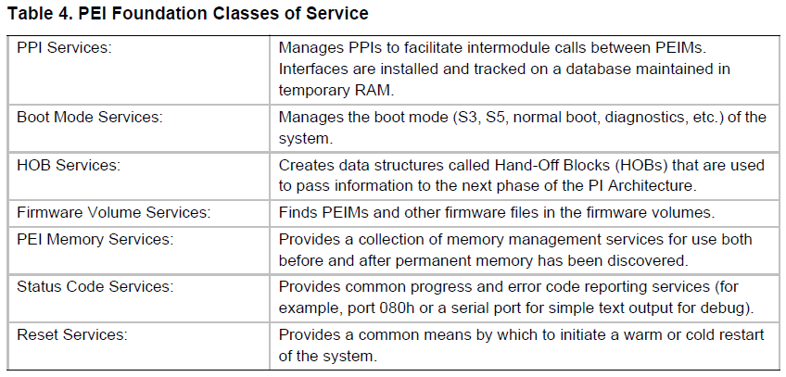
Components of PEI
PEI Services
Available for use to all PEIMs and PPIs as well as the PEI foundation itself
Wide variety of services provided (InstallPpi(), LocateFv(), etc.)
Extensive list of all PPIs can be found in Platform Initialization Spec Vol. 1, Version 1.3, Section 3.1

Slide 26
As the tables turn… PEI Services Table
typedef struct _EFI_PEI_SERVICES {
EFI_TABLE_HEADER Hdr;
EFI_PEI_INSTALL_PPI InstallPpi;
EFI_PEI_REINSTALL_PPI ReInstallPpi;
EFI_PEI_LOCATE_PPI LocatePpi;
EFI_PEI_NOTIFY_PPI NotifyPpi;
EFI_PEI_GET_BOOT_MODE GetBootMode;
EFI_PEI_SET_BOOT_MODE SetBootMode;
EFI_PEI_GET_HOB_LIST GetHobList;
EFI_PEI_CREATE_HOB CreateHob;
EFI_PEI_FFS_FIND_NEXT_VOLUME FfsFindNextVolume;
EFI_PEI_FFS_FIND_NEXT_FILE FfsFindNextFile;
EFI_PEI_FFS_FIND_SECTION_DATA FfsFindSectionData;
EFI_PEI_INSTALL_PEI_MEMORY InstallPeiMemory;
EFI_PEI_ALLOCATE_PAGES AllocatePages;
EFI_PEI_ALLOCATE_POOL AllocatePool;
EFI_PEI_COPY_MEM CopyMem;
EFI_PEI_SET_MEM SetMem;
EFI_PEI_REPORT_STATUS_CODE ReportStatusCode;
EFI_PEI_RESET_SYSTEM ResetSystem;
EFI_PEI_CPU_IO_PPI CpuIo;
EFI_PEI_PCI_CFG_PPI PciCfg;
} EFI_PEI_SERVICES;
Phoenix Wiki has good descriptions of what they all do:
http://wiki.phoenix.com/wiki/index.php/EFI_PEI_SERVICES

Slide 27
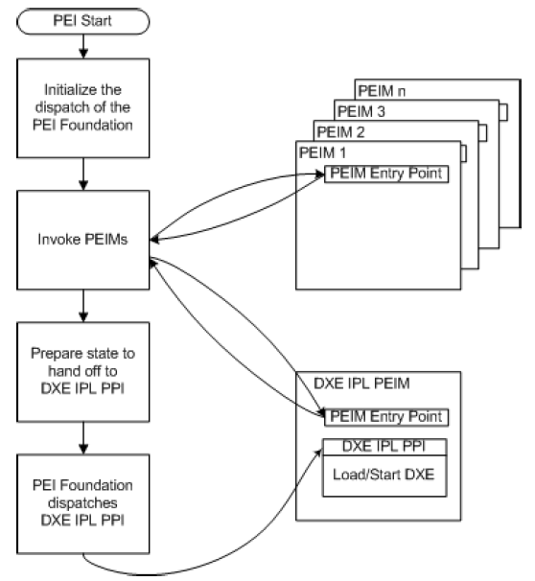
PEI Phase
This is a basic diagram of the PEI operations performed by the PEI Foundation
The PEI foundation builds the PEI Services table
The core of it centers around the PEI Dispatcher which locates and executes PEIMs
Initializing permanent memory, etc.
One of these PEIMs will be the DXE IPL (Initial Program Load) PEIM which will perform the transition to the DXE phase when all PEIMs that can be invoked have been invoked
PEI Dispatcher Invokes PEIMs
Platform Initialization Spec Vol. 1, Version 1.3, Section 2.4

Slide 28
PEI Dispatcher
The PEI Dispatcher is a state machine and central to the PEI phase
Evaluates each dependency expressions (DEPEXes) of PEIMs which are evaluated
DEPEX is a list of list of GUIDs for PPIs & some logic associated with the condition that is desired (e.g. PPI must be loaded before this module’s DEPEX is satisfied)
If the DEPEX evaluates to True, the PEIM is invoked, otherwise the Dispatcher moves on to evaluate the next PEIM
One PPI is EFI_FIND_FV_PPI so every PEIM on every Firmware Volume can be invoked
Once all PEIMs that can execute have been, the last PEIM executed is the DXE IPL PEIM which hands off to DXE phase
X
PEIM A
Y
UEFI will prevent both PEIMs A and B in this endless cycle from executing.
X and Y are PPIs
Y
PEIM B
X

Slide 29
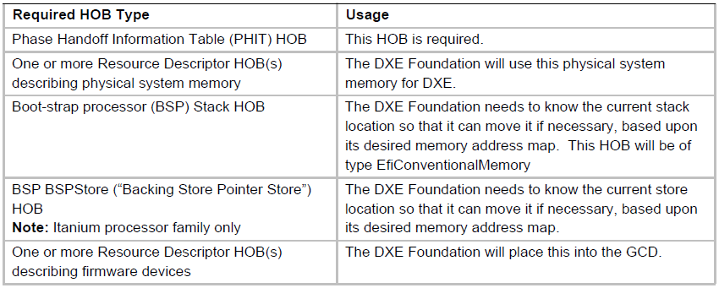
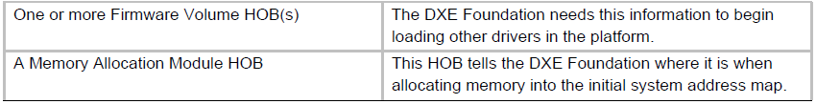
Exit conditions for handoff to DXE
The HOB List must contain the following HOBs:

Slide 30
Driver Execution Environment (DXE)
The DXE phase is designed to be executed at a high-enough level where it is independent from architectural requirements
Similar to PEI from a high-level; it creates services used by DXE, has a dispatcher that finds and loads DXE drivers, etc.
System Management Mode set up, Secure Boot enforcement and BIOS update signature checks are typically implemented in this phase. Therefore it is the most security-critical.

Slide 31
PEI is to DXE as…
PEIMs are to DXE Drivers
PEI Dispatcher is to DXE Dispatcher
DXE uses an almost identical system as PEI to load and invoke individual units of functionality, as required by the DEPEXs
PPI is to Protocol
DXE drivers register and lookup "protocols"
Sec Core Data are to HOBs
PEI gets Sec Core Data from SEC, DXE gets HOBs from PEI

Slide 32
DXE Phase
Use this for mental visualization, but make the following substitutions
s/PEI/DXE/g
s/PEIM/DXE Driver/g
s/DXE IPL/BDS IPL/g
PEI Dispatcher Invokes PEIMs
Platform Initialization Spec Vol. 1, Version 1.3, Section 2.4

Slide 33
As the tables turn… DXE Services Table
typedef struct {
EFI_TABLE_HEADER Hdr;
EFI_ADD_MEMORY_SPACE AddMemorySpace;
EFI_ALLOCATE_MEMORY_SPACE AllocateMemorySpace;
EFI_FREE_MEMORY_SPACE FreeMemorySpace;
EFI_REMOVE_MEMORY_SPACE RemoveMemorySpace;
EFI_GET_MEMORY_SPACE_DESCRIPTOR GetMemorySpaceDescriptor;
EFI_SET_MEMORY_SPACE_ATTRIBUTES SetMemorySpaceAttributes;
EFI_GET_MEMORY_SPACE_MAP GetMemorySpaceMap;
EFI_ADD_IO_SPACE AddIoSpace;
EFI_ALLOCATE_IO_SPACE AllocateIoSpace;
EFI_FREE_IO_SPACE FreeIoSpace;
EFI_REMOVE_IO_SPACE RemoveIoSpace;
EFI_GET_IO_SPACE_DESCRIPTOR GetIoSpaceDescriptor;
EFI_GET_IO_SPACE_MAP GetIoSpaceMap;
EFI_DISPATCH Dispatch;
EFI_SCHEDULE Schedule;
EFI_TRUST Trust;
EFI_PROCESS_FIRMWARE_VOLUME ProcessFirmwareVolume;
} EFI_DXE_SERVICES;
Phoenix Wiki has good descriptions of what they all do:
http://wiki.phoenix.com/wiki/index.php/EFI_DXE_SERVICES

Slide 34
As the tables turn… Boot Services Table 1
typedef struct {
EFI_TABLE_HEADER Hdr;
EFI_RAISE_TPL RaiseTPL;
EFI_RESTORE_TPL RestoreTPL;
EFI_ALLOCATE_PAGES AllocatePages;
EFI_FREE_PAGES FreePages;
EFI_GET_MEMORY_MAP GetMemoryMap;
EFI_ALLOCATE_POOL AllocatePool;
EFI_FREE_POOL FreePool;
EFI_CREATE_EVENT CreateEvent;
EFI_SET_TIMER SetTimer;
EFI_WAIT_FOR_EVENT WaitForEvent;
EFI_SIGNAL_EVENT SignalEvent;
EFI_CLOSE_EVENT CloseEvent;
EFI_CHECK_EVENT CheckEvent;
EFI_INSTALL_PROTOCOL_INTERFACE InstallProtocolInterface;
EFI_REINSTALL_PROTOCOL_INTERFACE ReinstallProtocolInterface;
EFI_UNINSTALL_PROTOCOL_INTERFACE UninstallProtocolInterface;
EFI_HANDLE_PROTOCOL HandleProtocol;
VOID* Reserved;
Phoenix Wiki has good descriptions of what they all do:
http://wiki.phoenix.com/wiki/index.php/EFI_BOOT_SERVICES

Slide 35
As the tables turn… Boot Services Table 2
EFI_REGISTER_PROTOCOL_NOTIFY RegisterProtocolNotify;
EFI_LOCATE_HANDLE LocateHandle;
EFI_LOCATE_DEVICE_PATH LocateDevicePath;
EFI_INSTALL_CONFIGURATION_TABLE InstallConfigurationTable;
EFI_IMAGE_LOAD LoadImage;
EFI_IMAGE_START StartImage;
EFI_EXIT Exit;
EFI_IMAGE_UNLOAD UnloadImage;
EFI_EXIT_BOOT_SERVICES ExitBootServices;
EFI_GET_NEXT_MONOTONIC_COUNT GetNextMonotonicCount;
EFI_STALL Stall;
EFI_SET_WATCHDOG_TIMER SetWatchdogTimer;
EFI_CONNECT_CONTROLLER ConnectController;
EFI_DISCONNECT_CONTROLLER DisconnectController;
EFI_OPEN_PROTOCOL OpenProtocol;
EFI_CLOSE_PROTOCOL CloseProtocol;
Phoenix Wiki has good descriptions of what they all do:
http://wiki.phoenix.com/wiki/index.php/EFI_BOOT_SERVICES

Slide 36
As the tables turn… Boot Services Table 3
EFI_OPEN_PROTOCOL_INFORMATION OpenProtocolInformation;
EFI_PROTOCOLS_PER_HANDLE ProtocolsPerHandle;
EFI_LOCATE_HANDLE_BUFFER LocateHandleBuffer;
EFI_LOCATE_PROTOCOL LocateProtocol;
EFI_INSTALL_MULTIPLE_PROTOCOL_INTERFACES InstallMultipleProtocolInterfaces;
EFI_UNINSTALL_MULTIPLE_PROTOCOL_INTERFACES UninstallMultipleProtocolInterfaces;
EFI_CALCULATE_CRC32 CalculateCrc32;
EFI_COPY_MEM CopyMem;
EFI_SET_MEM SetMem;
EFI_CREATE_EVENT_EX CreateEventEx;
} EFI_BOOT_SERVICES;
Phoenix Wiki has good descriptions of what they all do:
http://wiki.phoenix.com/wiki/index.php/EFI_BOOT_SERVICES

Slide 37

As the tables turn… Runtime Services Table
typedef struct {
EFI_TABLE_HEADER Hdr;
EFI_GET_TIME GetTime;
EFI_SET_TIME SetTime;
EFI_GET_WAKEUP_TIME GetWakeupTime;
EFI_SET_WAKEUP_TIME SetWakeupTime;
EFI_SET_VIRTUAL_ADDRESS_MAP SetVirtualAddressMap;
EFI_CONVERT_POINTER ConvertPointer;
EFI_GET_VARIABLE GetVariable;
EFI_GET_NEXT_VARIABLE_NAME GetNextVariableName;
EFI_SET_VARIABLE SetVariable;
EFI_GET_NEXT_HIGH_MONO_COUNT GetNextHighMonotonicCount;
EFI_RESET_SYSTEM ResetSystem;
EFI_UPDATE_CAPSULE UpdateCapsule;
EFI_QUERY_CAPSULE_CAPABILITIES QueryCapsuleCapabilities;
EFI_QUERY_VARIABLE_INFO QueryVariableInfo;
} EFI_RUNTIME_SERVICES;
Used for our ring 3 BIOS exploit - BH USA 2014, by Kallenberg et al. [31] CERT VU # 552286
SetVariable also used for CERT VU #758382. Co-discovered with Intel, and first described at CSW 2014
Phoenix Wiki has good descriptions of what they all do:
http://wiki.phoenix.com/wiki/index.php/EFI_RUNTIME_SERVICES
Notes:
Mention that the runtime services table was found lingering about in memory on some HPs, even when they booted a non-UEFI system…

Slide 38


Relative magnitude of PEIMs vs. DXE drivers
Machine release dates are not definitive, just based on first page of Google previews
(3/2011) Lenovo X220: 65 PEIMs, 278 DXE drivers
(1/2014) Lenovo X240: 80 PEIMs, 352 DXE drivers
(3/2010) HP Elitebook 2540p: 42 PEIMs, 164 DXE drivers
(1/2014) HP Elitebook 850 G1: 117 PEIMs, 392 DXE drivers
(11/2010) Dell Latitude E6410: 32 PEIMs, 315 DXE drivers
(2/2014) Dell Latitude E6440: 63 PEIMs, 456 DXE drivers
DXE has got it going on!
Increase in code & complexity over time? Sounds like we're on the highway to hell, not a stairway to heaven…
Notes:
http://th04.deviantart.net/fs70/300W/i/2011/115/6/8/cd_review_acdc_hwth_by_stumander1989-d3eum5v.jpg
http://www.aadityatiwari.com/wp-content/uploads/2013/07/Led_Zeppelin_Post/1.jpg?w=190&h=190&zc=1&s=0&a=t&q=89http://www.aadityatiwari.com/wp-content/uploads/2013/07/Led_Zeppelin_Post/1.jpg?w=190&h=190&zc=1&s=0&a=t&q=89

Slide 39

UEFI Non-Volatile Variables
The (much more extensible and (eventually) secure) replacement for "CMOS" / "NVRAM" as a BIOS configuration mechanism
Stored on the SPI flash chip along with the rest of the BIOS code
Growing pains: there've been at least two examples (Samsung & Lenovo) of systems that were implemented incorrectly and once the variable space was filled up (e.g. accidentally by an OS logging mechanism), the system was bricked
Can be accessed in PEI (the CapsuleUpdate variable of VU#552286 fame certainly was), but overall, variables are more likely to be accessed in DXE and later phases (up to and including runtime)
Samsung - http://mjg59.dreamwidth.org/22028.html
Lenovo - https://bugzilla.redhat.com/show_bug.cgi?id=919485
Notes:
http://pixabay.com/p-153405/?no_redirect

Slide 40
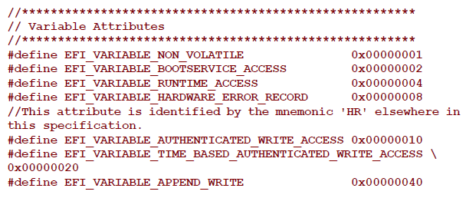
EFI Variable Attributes
Each UEFI variable has attributes that determine how the firmware stores and maintains the data:
‘Non_Volatile’
The variable is stored on flash
‘Bootservice_Access’
Can be accessed/modified during boot. Must be set in order for Runtime_Access to also be set
* UEFI 2.3.1 Errata C Final

Slide 41


EFI Variable Attributes
‘Runtime_Access’
The variable can be accessed/modified by the Operating System or an application
‘Hardware_Error_Record’
Variable is stored in a portion of NVRAM (flash) reserved for error records
‘Authenticated_Write_Access’
The variable can be modified only by an application that has been signed with an authorized private key (or by present user)
KEK and DB are examples of Authorized variables
‘Time_Based_Authenticated_Write_Access’
Variable is signed with a time-stamp
‘Append_Write’
Variable may be appended with data
Notes:
https://openclipart.org/detail/12538/game-baddie:-angel-by-nicubunu
https://openclipart.org/detail/195461/angel-by-sixsixfive-195461

Slide 42
EFI Variable Attributes Combinations
If a variable is marked as both Runtime and Authenticated, the variable can be modified only by an application that has been signed with an authorized key
If a variable is marked as Runtime but not as Authenticated, the variable can be modified by any application
The Setup variable (of VU#758382 fame) is marked like this
Goto “SetupForFailure” slides

Slide 43
Looking at NVARs w/ ChipSec
Copy Chipsec_Install to C:\Chipsec_Install
(If you don’t already have python 2.7 installed) run the Python 2.7.9 installer
NOTE: on the “Customize Python 2.7.9” page, make sure you select the “Add python.exe to Path” which is just barely visible at the bottom (you need to scroll down)
Run the pywin32 installer
From admin cmd prompt:
Bcdedit /set TESTSIGNING ON
shutdown /r /t 0

Slide 44
Looking at NVARs w/ ChipSec
From admin cmd prompt
cd C:\ChipSec_Install\chipsec-master1-30-2015\chipsec-master\source\tool
python chipsec_main.py
(will do the basic vulnerability checks)
python chipsec_util.py uefi nvram nvar C:\Copernicus_BIOS.bin
Or possibly
python chipsec_util.py uefi nvram vss C:\Copernicus_BIOS.bin
Will parse out UEFI nvars and place them in the folder
C:\Copernicus_BIOS.bin.nvram.dir

Slide 45
"Authenticate how?" Keys and Key Stores
UEFI implements 4 variables which store keys, signatures, and/or hashes:
Platform Key (PK)
"The platform key establishes a trust relationship between the platform owner and the platform firmware." - spec
Controls access to itself and the KEK variables
Only a physically present user or an application which has been signed with the PK is supposed to be able to modify this variable
Required to implement Secure Boot, otherwise the system is in Setup Mode where keys can be trivially modified by any application
Key Exchange Key (KEK)
"Key exchange keys establish a trust relationship between the operating system and the platform firmware." - spec
Used to update the signature database
Used to sign .efi binaries so they may execute
Signature Database (DB)
A whitelist of keys, signatures and/or hashes of binaries
Forbidden Database (DBX)
A blacklist of keys, signatures, and/or hashes of binaries
UEFI Version 2.3.1, Errata C
Notes:
PK may be updated by an authentication descriptor signed with the platform key

Slide 46
UEFI Variables (Keys and Key Stores) 2
As stated earlier, these variables are stored on the Flash file system
Thus, if the SPI flash isn’t locked down properly, these keys/hashes can be overwritten by an attacker
The problem is, the UEFI variables must rely solely on SMM to protect them!
The secondary line of defense, the Protected Range registers cannot be used
The UEFI variables must be kept writeable because at some point the system is going to need to write to them
See our "Setup for Failure" [29] talk to see an example of SMI suppression to write to the DB to whitelist the "Charizard" PoC bootkit (also check out the video ;) [33])
Notes:
PK may be updated by an authentication descriptor signed with the platform key

Slide 47
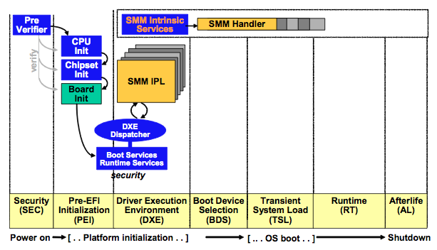
DXE & SMM, BFF 4EVA!
DXE loads SMM IPL
SMM IPL loads SMM Core
SMM Core loads SMM drivers

Slide 48

Boot Device Selection (BDS)
Runtime
Interface
The BDS will typically be encapsulated into a single file loaded by the DXE phase.
It consults the configuration information to decide whether you're going to boot an OS or "something else"
It has access to the full UEFI Boot Services Table of services that DXE set up. E.g. HD filesystem access to find an OS boot loader
So that should tell you an attacker in DXE gets that capability too
Notes:
http://pixabay.com/en/costume-demon-devil-board-female-15839/

Slide 49
I give unto thee: an interface!
Unlike the transition from SEC -> PEI or PEI -> DXE, there's no collecting of information to give to BDS
Instead what's given is a pointer to the system table, which in turn points to the boot services and DXE services tables, for the BDS (and next) phase(s) to use as need be.

Slide 50

Transient System Load (TSL)
Runtime
Interface
This is the point where we hand off from firmware-derived code, to typically HD-stored code.
If the system is running with SecureBoot turned on, the BDS will have checked the signature before loading code in this phase, and denies anything un-signed (e.g. super 1337 "Oooh look at me, I made the first UEFI bootkit!!1" bootkits ;))
Notes:
http://pixabay.com/p-24996/?no_redirect

Slide 51
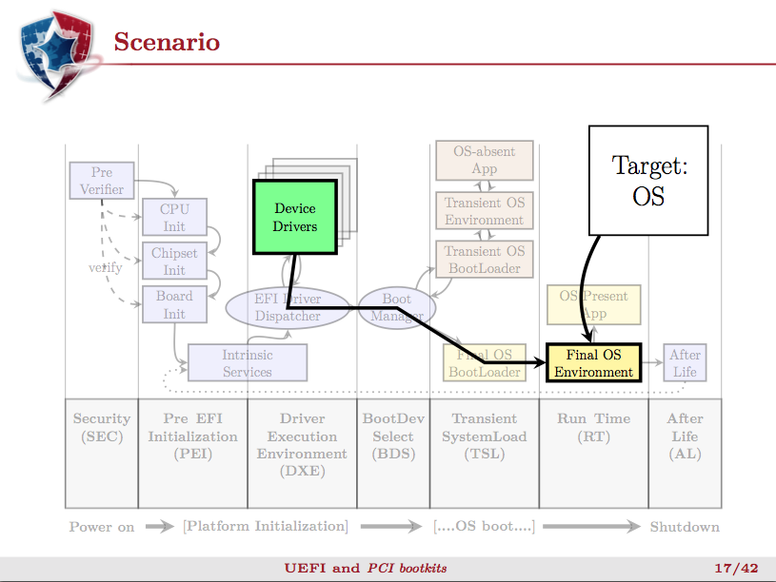

Pierre Chifflier, UEFI and PCI Bootkits, PacSec 2013 [34]
Notes:
http://www.zenzoneforum.com/attachment.php?attachmentid=16863&d=1341138411

Slide 52



Pierre Chifflier, UEFI and PCI Bootkits, PacSec 2013 [34]
Rootkit Detection Framework for UEFI (RDFU),
Vuksan & Pericin, BH USA 2013 [35]
What if we forced boot to go through a randomized OS absent security application (that ideally uses the TPM/TXT to ensure its trustworthiness?)
Notes:
http://jm08191998.deviantart.com/art/I-m-an-Angel-329596617
https://www.flickr.com/photos/slingo/2401350426/

Slide 53
Run Time (RT)
Runtime
Interface
Typically when the OS boot loader is done, it will call ExitBootServices() in the UEFI Boot Services table. This will reclaim the majority of UEFI memory so the OS can use it
However some memory is retained, to be used for the Runtime Services Table talked about a while ago

Slide 54

After Life (AL)
We haven't checked extensively, but we don't think anyone is doing anything with this right now
We think it's just something put there so that architecturally they would have the option to do "stuff" upon graceful shutdown (e.g. clearing secrets?)
Notes:
http://pixabay.com/p-153600/?no_redirect

Slide 55

Conclusion

